Slide 1


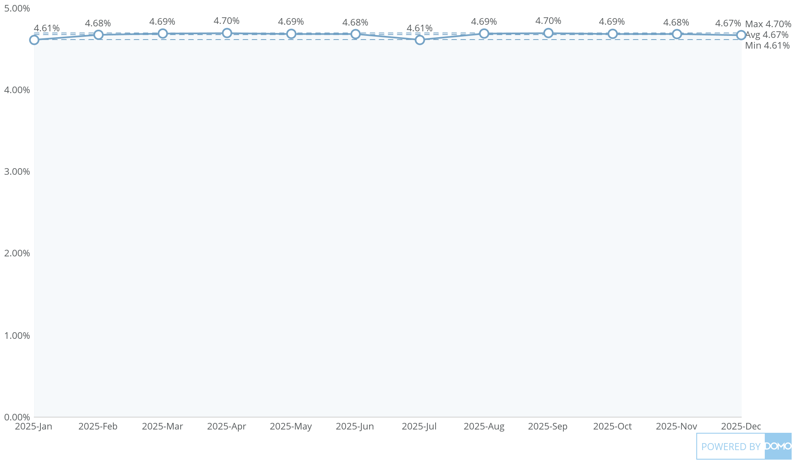
+
exported May 17, 2025, 12:37:00 PM UTC
PE3|Card 1|Bonus Penalty Month on Month
This Year, by Month

